Slide 1

Bank Customer Analytics
-
Submitted By: Krishna Gopal Goswami

Slide 2
Agenda
Business Objectives
Data Preparation
Analysis
Models
Insights

Slide 3
Business Objectives
Find Key Insights in the data using Visual Analytics
How to increase Revenue and reduce cost

Slide 4
Data Understanding

Slide 5
Brief about the dataset
The dataset contains Customer Data of ~4000 customers.
Following fields are available in the dataset:
Customer ID – Unique Id of the customer
Name – Customer Name
SurName – SurName of the customer
Gender – Gender of the customer
Age – Age of the customer
Region – Region of the customer
Job Classification – Job Type of the customer
Date Joined – The date when customer joined the bank
Balance – Current balance of the customer

Slide 6
Data Analysis

Slide 7
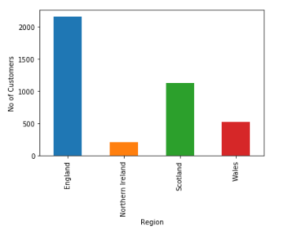
Check No of Customers by Region
From the bar plot, it is clear that
England has highest number of customers
And Northern Island has lowest number
of customers.

Slide 8
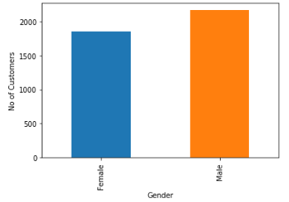
Check No of Customers by Gender
From the bar plot, it is clear that no of Male customers is greater than no of Female customers

Slide 9
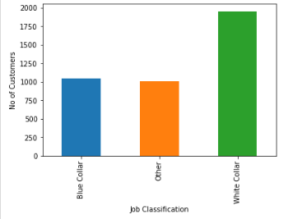
Check No of Customers by Job Classification
From the bar plot, it is clear that
No of customers is highest for White Colour
Job and is lowest for Other category

Slide 10
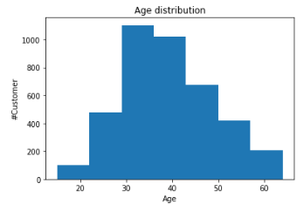
Check Distribution of Age
From the Histogram ,it can be concluded
that most of the customers are between
Age 30 and 50 years

Slide 11
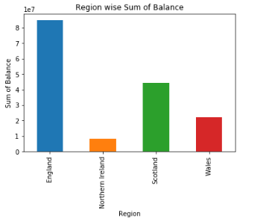
Check Region wise Balance
From the Histogram ,it can be concluded
that Customers from England has highest sum
Of balances.

Slide 12
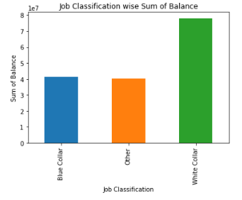
Check Job Classification wise Balance
From the Histogram ,it can be concluded
that Customers with White Color Job classification
has highest sum of balances.

Slide 13
Check Job Classification wise Balance
From the Histogram ,it can be concluded
that Customers with White Color Job classification
has highest sum of balances.

Slide 14
GitHub Link
The project is developed using Python and the python can be downloaded from the below GitHub Link:
https://github.com/kgopal1982/Analytics/blob/master/VisualAnalyticsAssessment/Krishna_Visual_Analytics.ipynb

Slide 15
Thank You

